Slide 1
AAC: A different method but the same message (and why it matters)
Mariesa Rang, MA, CCC-SLP
Sharon Mankey, MAT, CCC-SLP
Purdue University Fort Wayne
Notes:
This program was started by Sharon Mankey & Mariesa Rang, both of whom are SLPs in Fort Wayne, Indiana. They started the program because of their concern with the possibility that people who use AAC may be dismissed by first responders solely because the responders lack the training to communicate effectively with the “AAC User.”
The purpose of the training is to raise the first responders’ knowledge and comfort level in working with those who use AAC so that in the event of an emergency, the individual can be better served.
[Introduce yourselves and why you became involved.]

Slide 2
What will be covered At the end of the in-service, the participant will know:
what is AAC
data that shows people with disabilities are often victims of crime
what to expect when communicating with someone who uses AAC
and will have a “hands on” experience using devices
Notes:
During this presentation, we will tell you what AAC means & who might use it, we talk about data that shows people with disabilities are often victims of crime, and what to expect when communicating with someone who uses AAC. We also have videos of individuals using their communication devices. At the end of our session, we have some role-playing scenarios that will give you some hands-on experience with devices that we brought with us.

Slide 3
Daniel Webster:
If my possessions were taken from me with one exception I would choose to keep the power of communication, for by it I would soon regain all the rest.
Notes:
As we start things off, we want to share this quote from Daniel Webster. We feel like it exemplifies the importance of communication – that when we communicate we have power. We get things done. We share information and ask questions of one another. We have relationships and interactions. People who are nonverbal may not have the same opportunities and lose out on having personal relationships with others. We want you to keep this quote in mind as we go through the rest of our presentation.

Slide 4
What is AAC?
Name ways to communicate:
Augmentative:
Alternative:
A.K.A.: “Talker,” Speech Generating Device or SGD, the iPad, communication board, AAC device, etc.
Communication should be effective and efficient
Notes:
How do we communicate? Speaking, telephoning, pointing, gestures, texting, emailing, facial/body expressions or movements, signing, writing, spelling, eye gaze, etc.
First, let’s talk about defining AAC. The first A stands for Augmentative which means someone is using a different means to HELP him/her communicate because what they can communicate may be difficult to understand completely. Perhaps someone has a good deal of energy early in the day but as time goes on, that energy wanes and their speech becomes more difficult to understand.
The second A stands for Alternative which means the person is using a different means to communicate because they cannot make needs/wants, etc. known verbally. They use the communication system to communicate. They may still make noises (for instance an indication of yes or no) but to be understood, they must use a system.
The C stands for Communication which is simply the exchange of information to meet an end, to share information, feelings, and ideas with another person. We need to understand and respond to the information shared.
Communication needs to be:
Effective – it is understood so that action can be taken
Efficient – it needs to be done in a timely manner. Verbal speech is spoken between 100-225 words per minute. Any slower, we tend to get impatient. Faster, we have more difficulty in keeping up and understanding it. Augmentative Communication is much, much slower; sometimes a word a minute.
Bottom line: It can be effective, but it probably won’t be as fast. Patience is needed.
Another point to consider is the influence of NONVERBAL cues tone, pitch, loudness, posture, proxemics, use of time, mannerisms. 20% of the meaning is derived from the words we use, but 80% comes from the other things that I just mentioned. I use the word “What” and say it in a variety of ways to show that one word said differently can be perceived as a question, angry, irritated, unsure, - a variety of emotions. [Have fun with this.] Though it is improving, these are not often part of AAC.

Slide 5
Who uses AAC?
Developmental: autism, cerebral palsy, MD, Down syndrome, apraxia, dysarthria, cognitive impairment, tracheostomy, etc.
Acquired: CVA, MS, ALS, apraxia, dysarthria, TBI, selective mutism, cognitive impairment, tracheostomy, spinal cord injury, etc.
Skills may be rudimentary to expert and may depend on the level of intelligence
Don’t judge the person by their packaging!
Notes:
Now that we know what AAC is, let’s talk a little bit about who you might see use it. It could be an individual with a developmental disability. This could be someone with autism, Down syndrome, or cerebral palsy. It could also be someone who had typical speech & language and then had an accident or illness later in life that took away that ability, such as someone who had a stroke, a traumatic brain injury, or someone who developed ALS (or Lou Gehrig’s Disease).
There are a couple of terms here that you may not be familiar with – apraxia and dysarthria. Apraxia means that the person cannot sequence the motor movements needed for speech. The individual knows what he or she wants to say but cannot get the signal from the brain to the mouth to be able to form the sounds in the words. [We give them a little demonstration of what groping movements may look like with apraxia.] Dysarthria means the person has muscle weakness in the muscles needed for speech. The easiest example to give for this is “drunk speech.” The words are slurred together and difficult to understand. It’s important to note that people with dysarthria are not drunk; they simply have some kind of brain damage that impacts their ability to form words clearly.
Along with the different conditions people may have, they may have a range of ability level. You may see someone who has had his/her device for 5 years, so s/he may be very familiar with the device, know where vocabulary is stored, and how to put words together to formulate a sentence for you. You may also see someone who is brand new to AAC; this person may not know where vocabulary is programmed and may need even more time to put together a message. The bottom line here is to not judge the person by his/her appearance. One of the most intelligent persons I know also happens to have cerebral palsy. If you were to simply look at his body, you might say that he is extremely impaired and not take time to talk with him. You could miss out on gathering critical information if you don’t talk to these individuals, so please look beyond their physical appearance and consider their cognitive abilities.
Don’t judge the person by their packaging? Think Stephen Hawking.

Slide 6
Misconceptions
If the person can’t talk, they probably aren’t aware, or smart, or competent or… you fill in the blank. (Prejudice)
A talking person can give better information (Prejudice)
It isn’t worth the time it takes to get the message (Impatience or emergency situation)
“It isn’t real life to wait so long for someone to say something.” (It is for them.)
Notes:
One of the more important things we want to come out of the in-service is to help first responders understand the importance of this training. We use this slide to explain what prejudice really is; an opinion formed unfairly or without knowing all of the facts.
We ALL prejudge. It is a survival skill for first responders. It shapes their thinking of how to handle the situation. It is for their protection.
Comments for each of the points above:
Unfortunately, when we prejudge based on someone appearance or communication skills (or lack there of) we marginalize them from their full value as a human being.
Because a person can’t talk verbally, it may have no reflection on their intellect – think of Steven Hawking! It just means they can’t talk.
A talking person may NOT be able to give information. Think of someone who is alone and is assaulted by a perpetrator. Someone comes along and finds them. If the officer only talks to the verbal person, he is getting hearsay information.
It isn’t worth the time? In an emergency, responders may not be able to take the time to talk to a person who is verbal. Treat the situation you have, but don’t leave out communication if you can take the time to do that. (Mankey understands emergencies as a former nurse and EMT!)
This last statement was said by someone with a PhD in speech/language pathology. It makes us terribly sad. It IS real life for that person. We need to respect that. We need to communicate for the benefit of people involved.

Slide 7
Why does it matter
Notes:
This is a new slide to our presentation. We added it because we want to highlight the fact that individuals who are nonverbal are being mistreated. It is showing up in our neighborhoods, schools, faith-based institutions, among so many others. It is not something that happens “somewhere else.” It is happening in our own backyards and is being reported in the media day in and day out.

Slide 8
Joan Petersilia (University of California – Irvine)
States that “people with developmental disabilities have a 4-10 times higher risk of becoming a crime victim than people without a disability.”
“Children with any kind of disability are more than twice as likely as nondisabled children to be physically abused and almost twice as likely to be sexually abused.”
Notes:
As we started putting together our presentation, we wanted to look at the research to ensure that we were giving good information. As we did this, we found two studies that we want to share with you. The first one is by Joan Petersilia out of the University of California-Irvine. Her research documented that “people with developmental disabilities have a 4-10 times higher risk of becoming a crime victim than people without a disability” and “children with any kind of disability are more than twice as likely as nondisabled children to be physically abused and almost twice as likely to be sexually abused.” This is important to understand as we all know that abuse is often perpetrated by someone that the victim knows – a family member, neighbor, or family friend. Therefore, if you respond to a domestic violence call, it is critical that you separate the parties, so that you can get accurate information regarding the situation. If you only talk to the verbal individual, you may be talking to the abuser, so you may not get the entire story.

Slide 9
Diane Bryen (Temple University)
From research study:
39% reported enduring a physical attack
39% reported experiencing unwanted sexual touch
28% reported being threatened of sexual assault or harm
22% reported being forced to have sex
17% reported being forced to touch someone sexually
Notes:
Dr. Bryen sent out a survey of people who use AAC and asked about crimes against them. These are her original data. She followed up with a second survey asking two questions. Did you return the survey? If not, why not? 50% reported that they did not return the survey because they were afraid of retaliation from the one who perpetrated the crime.
93% of crimes against people who have disabilities is by people with whom they have contact. These people include family members, caregivers, friends of family members, etc. It is typically NOT people off the street. If the first responder does not talk to the victim who uses AAC, they may be talking to the perpetrator him/herself. What kind of information will they get? The first responder MUST take the time to talk with the person who uses AAC in order to get the best information for the situation.
Rarely are these cases prosecuted and even if they are, there have been instances when the judge refused to allow the victim to testify stating that speaking that way was “not normal!” They were victimized again by the court!
Dr. Bryen said in a interview on PBS that (this is a paraphrase) “people (who use AAC) have reported being treated as furniture as dogs, as something less than human because the ability to speak is so innately human.”

Slide 10
The need to communicate in emergency situations:
People with disabilities may live in a variety of settings.
Name some:
Notes:
Children and adults with disabilities may live in a variety of situations. In the past, we hid people with disabilities away. They didn’t participate in school or social events. Parents were ostracized for taking their children out into public. I graduated with a young man I had known since I was 5 and found out only in our senior year that he had a disabled sister at home! Things have changed. YEA!
At home with family members - Aging parents, a spouse, or a sibling
In institutions (skilled nursing facilities, group homes)
In their own home – either alone or with a spouse, caregiver or other person
Situations that can occur that :
Adult children living with elderly parents and a parent has an emergency.
Adult person w/ disability living alone has an emergency
Car accident and driver becomes incapacitated
Young person with disabilities away at college and has an emergency in the dorm
House/building fire being reported by person who uses AAC
Others?

Slide 11
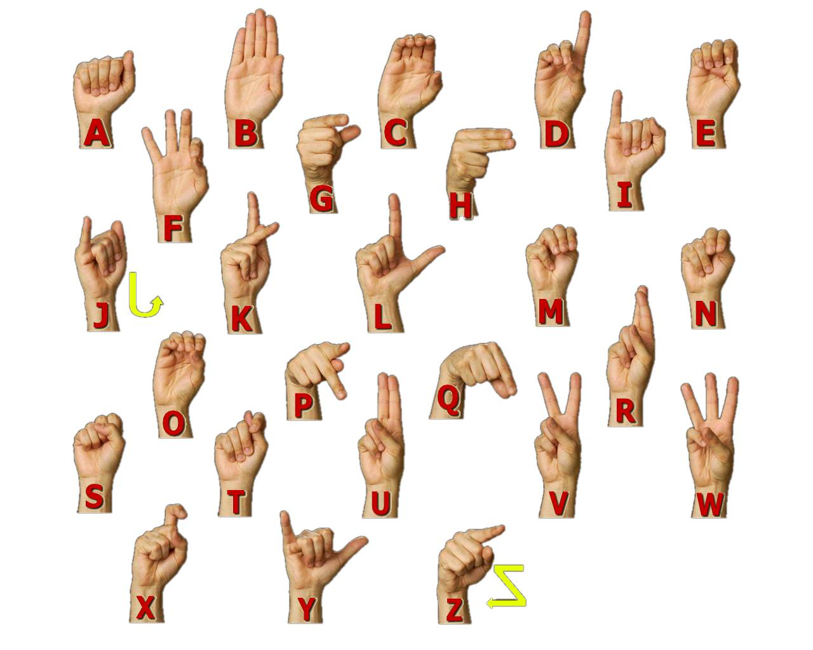
Types of AAC
No Tech
Signs (ASL, Signed English, other)
Gestures/Pointing
Body Language
Notes:
Next, we’re going to talk about the different types of AAC, so that you are aware of the different kinds of AAC you may see. There are 4 levels of AAC; the first is called “no tech.” This means the individual is not using any extra piece of equipment, only what he or she has on his/her body. This can include pointing, sign language, facial expressions, and body language. The important thing to remember is that there’s nothing “extra” being used.

Slide 12
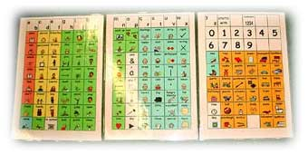
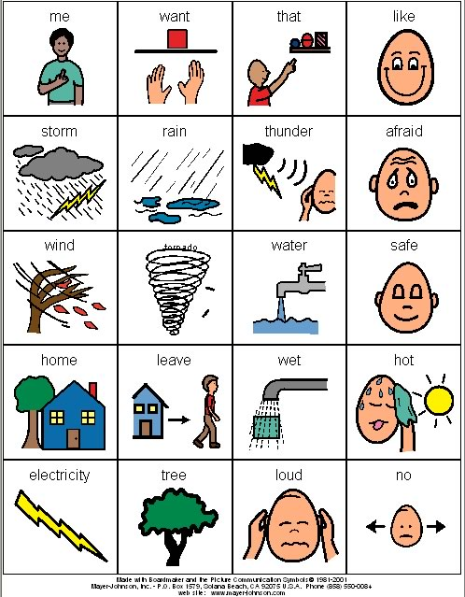
Types of AAC
Low tech uses non-voice output, pictures, symbols, books, boards, vests, typewriter etc.
Notes:
Once you pick up a pen to write something down, you’ve now entered “low tech.” Low tech includes writing, using pictures, and paper-based communication boards. There isn’t a voice output, so the communication partner needs to be looking at the individual and board to know what is being communicated.

Slide 13
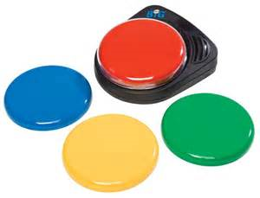
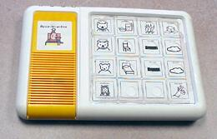
Types of AAC
Medium Tech
Voice output but limited vocabulary/sentence structure
(Voice in the Box, Go Talk, Big Mack Switch)
Notes:
Medium tech has a voice output, so the communication partner will now hear the message being communicated. These devices have limitations for vocabulary, and they require someone to record the messages into the device. This can be difficult, in that we need someone to be the same age and gender of our client – a 15 year old young man isn’t going to want to sound like a 60 year old woman. This level of AAC is limited, but it is giving the individual some amount of communication.

Slide 14
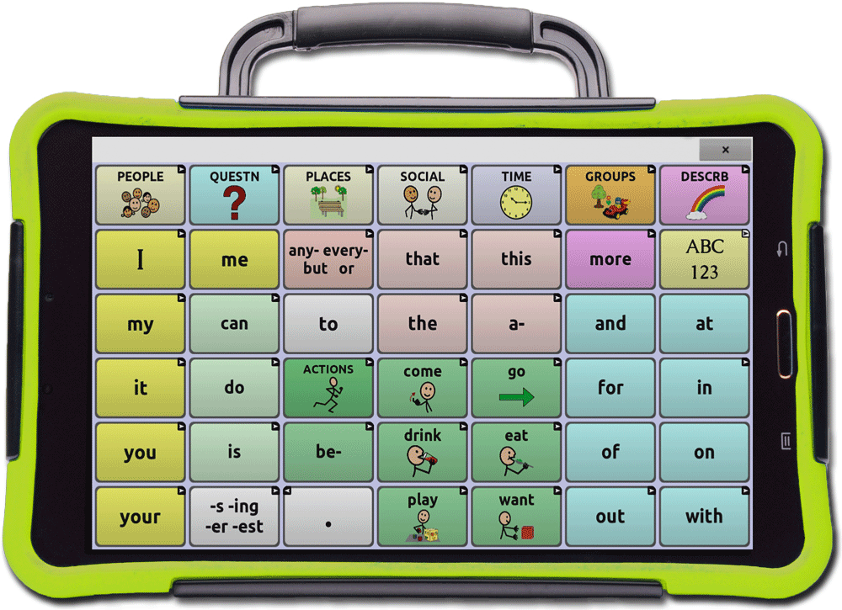
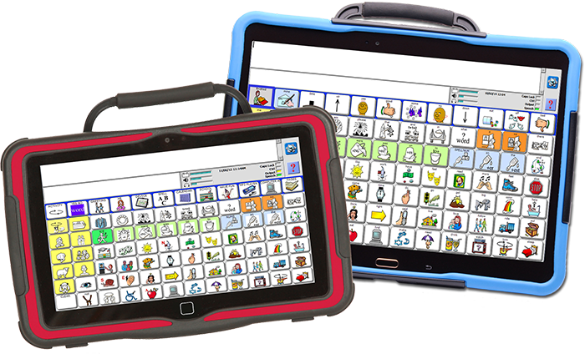
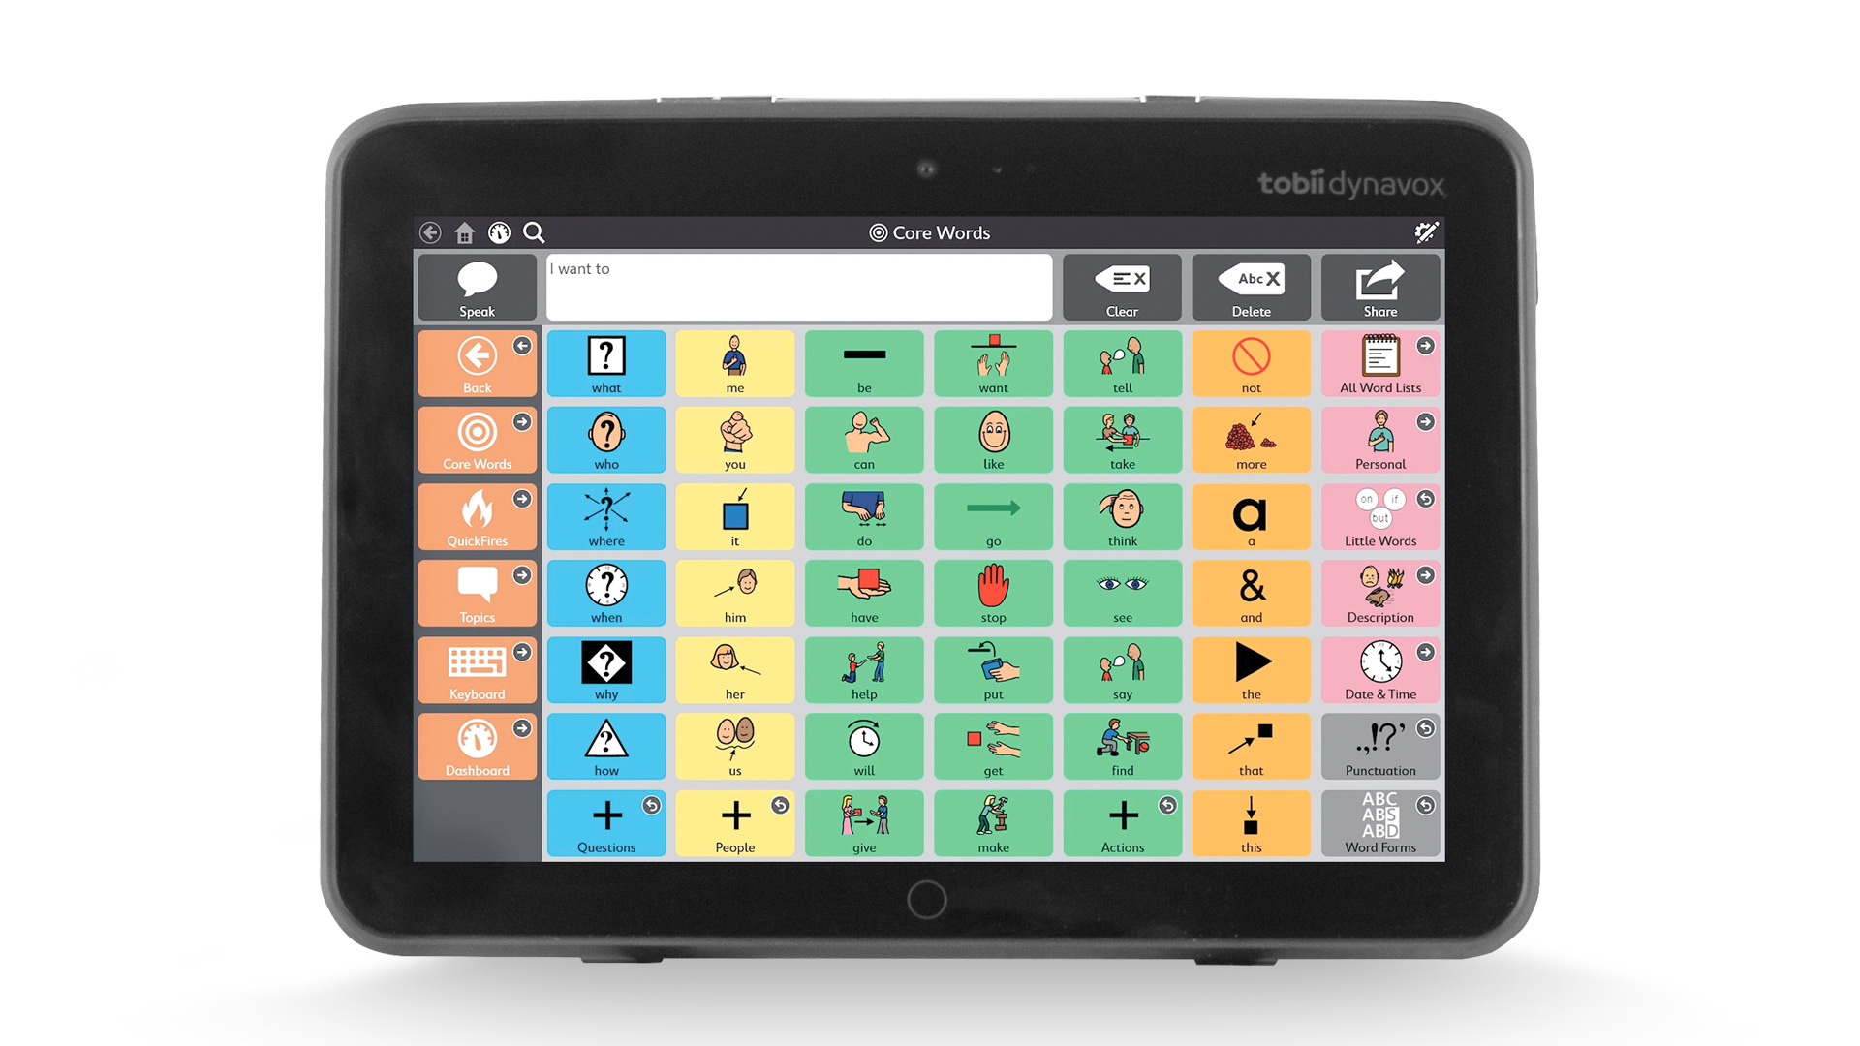
High tech uses communication devices with liquid crystal displays, voice output, electronics, scanning, switches, computers, etc.
Notes:
The final level of AAC is high tech, and this is the most sophisticated technology. These devices have a larger vocabulary available, and these devices can be used for environmental controls, such as turning up the heat in a house, opening doors, and they can be paired with a cell phone for texting or phone calls. Because of the sophistication of them, they are also very expensive; they can range from $8,000 to $20,000. I mention this in case you come upon a scene or situation and find one of these devices. Please pick it up and be cautious with it, for 2 reasons: first, if you are taking the individual somewhere (hospital, police station, etc.) s/he will need the device for communication at that location; secondly, since the devices are so expensive, it can be very difficult to request a new one if the first device is lost or left behind. It can also take several months for a new device to be acquired, and in the meantime, the individual would be without a means for communication. Please be mindful of this.
Even with high tech devices, one problem that may remain is that the tone, pitch, emphasis that we have with verbal speech is often absent with electronic speech. The person may be frightened or in a lot of pain and this will not be evidenced by HOW they say what they say. They do not have the inflection that draws our attention to what they are saying. Please be aware of this.

Slide 15
Access Methods
Direct select – generally faster method
Use of any body part
Use of a switch, joystick, head or chin pointer, or eyegaze
Scanning
Use any body part to access switch as device cycles through vocabulary
Notes:
Communication board via finger point, whole hand point, laser light point, head pointing, switch access for a rotary dial or auditory output device, and eye pointing.
If the person can directly select by one of the above methods/using a body part, communication is typically a LOT faster.
Scanning means that the person needs to activate a switch in some way to start the scanning process. (If you have a device to demonstrate how scanning takes place, it helps. We use a Tech Scan.) Show which icon you want to say and then scan [row/column or column/row] to get to the icon. Use a beep or silent waiting as you move your finger down and across to get to the word. Say the word if you don’t have a device that will scan. Scanning is typically SLOWER than direct select.
People with disabilities may miss a lot of opportunities to communicate. Their vocabularies may be limited. Be patient. Check in with them to make sure you are understanding what they mean.

Slide 16
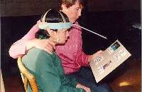
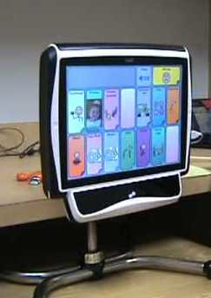
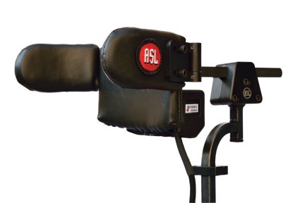
Head pointer
Direct selection with thumb or finger
Eye
gaze
Head switch array
Notes:
This slide shows some different ways to access devices.
The top left picture shows someone using a head stick with a low-tech board. Chin sticks are also use. This is direct selection because the user comes into contact with the board.
The top right picture shows a direct select method using a finger and a keyguard that makes it easier to select particular cells. We can’t be sure if the child is using her thumb or index finger to make the selection, but her whole hand is resting on the device. This cannot be done with an iPad.
Eye gaze (bottom left) can be performed in a variety of ways. It may simply be looking at an picture and the partner is on the other side of plexiglass noting where the eye gaze is. It may be done by the AAC device calibrating where the pupil of the user’s eye is so that as his/her eye moves, the device understands what the person is looking at. This is used by someone who does not have much movement.
The bottom right picture is another type of head pointer. This time connected to a high tech device anchored to a wheelchair. The user presses buttons in the headrest to move a cursor on the high tech device. A demonstration of this is shown later in this presentation (the Mike video).

Slide 17
What to do with motorized wheelchairs?
Visit NMEDA.com to determine the closest adapted vehicle vendor location
Call the vendor and ask them to send a vehicle to pick up the motorized wheelchair
Do not leave them on the side of the road or at an accident scene
Most motorized wheelchairs are over 300 pounds, so lifting them will be difficult, and they should not be transported on a flatbed towing truck

Slide 18
KC using his device by typing with his toe
https://www.youtube.com/watch?v=ciUMZrfaYjk
Notes:
KC is a man with CP and diplegia of the arms. His arms/hands cannot be used to access his device. His left arm is covered with a heavy athletic sock to provide stimulation it needs to prevent spasms. Without the sock, his arms fight each other frequently. Since he cannot access his device with his fingers, he uses his feet/toes.
Because he uses his feet, he has to look down when composing a message. He is hearing impaired and depends on reading lips to know what someone is saying. If the first responder is talking to him but KC is not looking at him, he will not hear/understand what is being said. You must get his attention first.
Also, keep in mind that when we speak, we think and say what we decide in a matter of a couple of seconds. Individuals who use AAC often have to hold what they want to say in their heads for minutes so that they say what they want to say. This is a mental feat to be sure!

Slide 19
Kevin
https://www.youtube.com/watch?v=B50gUwhRyXc
Notes:
Kevin is a young man with autism who looks, as his family says “normal.” They are afraid that first responders will not know this and will respond negatively to him if he does not respond to their commands.
People with autism have some common traits; however, they are all different in many ways. What works to calm one person down does not work with another. Generally a calm, quiet environment works best when needing to gain cooperation.

Slide 20
Bryanna
https://www.youtube.com/watch?v=4ahvfK3JPnk
Notes:
You’ll notice that all of the participants are wearing the same t-shirts; this is because they all come to a weekend theater camp held on the campus of Purdue Fort Wayne. The camp was started in 2009 and continues to educate the Fort Wayne community as to what AAC is and how people with disabilities use it. The campers come Friday evening, all day Saturday, Sunday afternoon, and by Sunday evening, they are ready to put on a short play performance. Here we have Bryanna, who is one of our star performers. You’ll notice that her communication device has more emotion than the others. Some devices have more inflection, but many of them still sound robotic. Bryanna has an important message for first responders.

Slide 21
Reality, or AAC talking in real time.
https://youtu.be/2kR2dHPY_CE
A couple of problems:
It usually takes a longer time to write a message than we want it to take.
The emotion we are used to doesn’t happen with most AAC devices so the message sounds stiff and unnatural.
Notes:
A couple of problems:
It usually takes a longer time to write a message than we want it to take.
The emotion we are used to doesn’t happen with most AAC devices so the message sounds stiff and unnatural.
Mike is a young man with CP who uses a head array for accessing his device and for moving his wheelchair. He and his dad decided to make a video of an emergency situation for us. It is of Mike having a heart attack…only Mike doesn’t know what the symptoms of a heart attack are, so be gentle!
Just notice the following:
1) Mike’s dad (the EMT) gives him eye contact in order to communicate with him. That’s how it should be done. For your education, he then goes around the back of Mike so you can see how Mike is accessing his vocabulary.
2) Mike is moving his head against the buttons in his headrest so the movements he is making are not random head-banging movements. He is telling the cursor to go up, down, left, and right in order to select vocabulary.
3) Notice that some words pop up so that he can just select them, others must be accessed by going to a couple of layers of vocabulary to find the right word.
4) You may now see why it takes so long for someone to compose something s/he wants to say.

Slide 22
Communicating with someone who uses AAC
1. PRESUME THEIR COMPETENCE. Help them only as much as they need help.
2. Make eye contact.
3. Ask ONE question.
Open ended
Closed ended
Yes/no
Notes:
As we wrap up the lecture portion of our presentation, we want to leave you with some tips for communicating with individuals using AAC. First and foremost, presume their competence. This means that if you see someone with a communication board or device, assume they know how to use it and have the physical capability to do so.
Next, you want to maintain eye contact with the individual, just as you would with anyone else. It all comes down to showing respect for the individual you are helping.
As you begin gathering information, it is important you ask only one question at a time. Individuals who use AAC may need more time to process your questions, so if you’re asking questions in a rapid fire manner, you may not get an accurate answer. It’s better if you ask one question, allow the person to answer, and then continue with your line of questioning. Open ended questions are best, but when you need answers quickly, yes/no questions can be effective. One point of caution, though; you need to determine how the individual says “yes” and “no.” Not everyone has a typical way of answering these questions, so it is essential for you to know this information. You can ask the person, “Show me how you say ‘yes’. Show me how you say ‘no’.” Once s/he does this, you can continue with your questions regarding the situation.

Slide 23
Communicating with someone who uses AAC
4. WAIT 10 – 20 seconds before re-prompting them.
Slow uptake & fast decay
5. After they answer, let them know what you heard.
6. Make sure I have access to my communication device at ALL TIMES!
7. Treat me as you would any other person.
Notes:
As we’ve mentioned throughout the presentation, patience and waiting are key components to gathering information. People who use AAC can have difficulty with processing your questions; two of the most common forms are “slow uptake” and “fast decay.” Slow uptake means the individual doesn’t hear the beginning of your question and fast decay means the individual fades out and misses the end of your question. The best way to counteract either of these is to say their name to get their attention and use short sentences or questions to gather information.
After the individual answers a question, it is important to repeat what you heard to ensure you have the information correct.
It really comes down to showing respect for the person and his/her communication needs. We realize that you have a lot of responsibilities and you may not always have the time to use these strategies. We simply ask that you use them when you can. Also, talk to the person, not the person with them. In the case of assault or abuse, separate the victim from others in the area so s/he feels more free to talk.

Slide 24
Let’s talk!

Slide 25
Contact information:
Sharon Mankey, MAT, CCC-SLP
sharon.mankey@pfw.edu
sharonmankey@outlook.com
Mariesa Rang, MA, CCC-SLP
rangm01@pfw.edu mariesa.rang@gmail.com
Sharon Cell: 260.437.5975

